Slide 1
Alumni of the Capacity Development Programs of The Nippon Foundation
Mao Hasebe
Project Coordinator
The Nippon Foundation

Slide 2
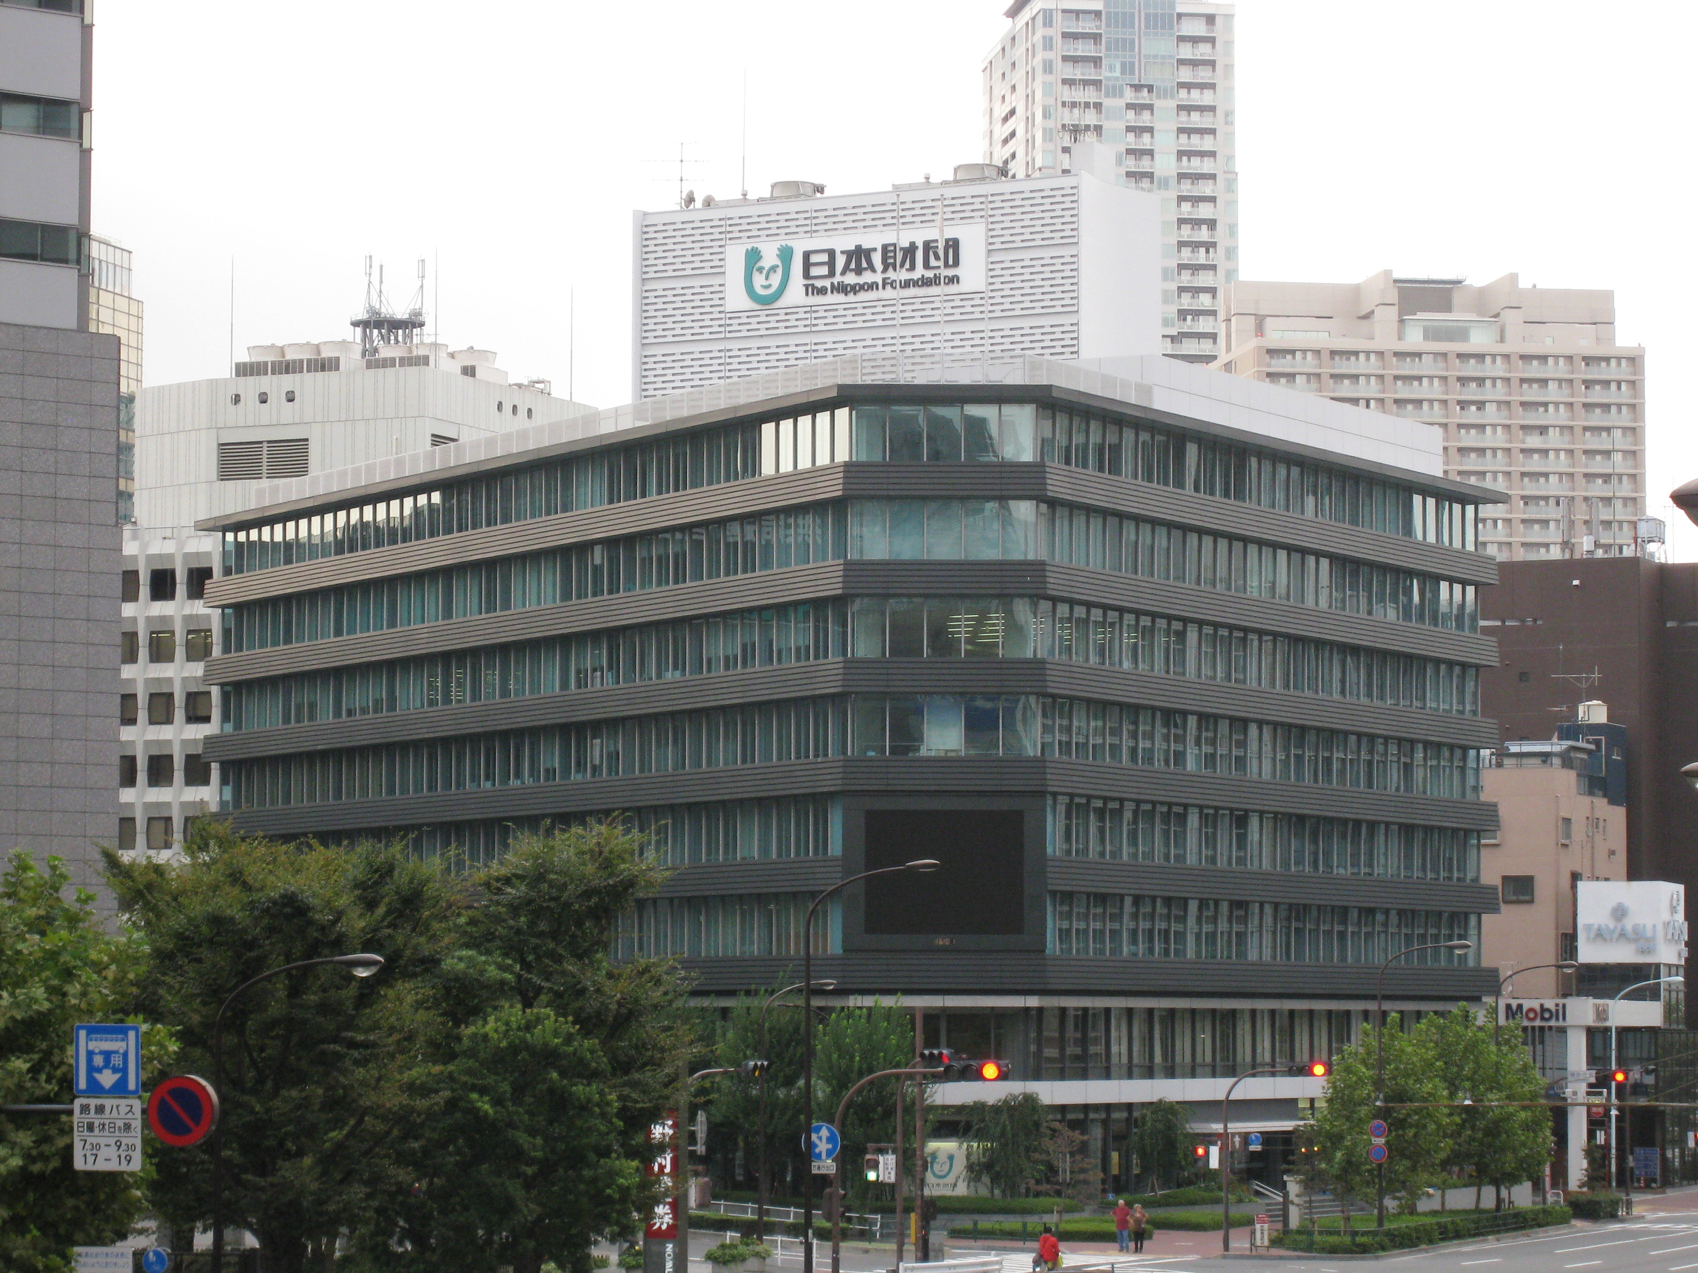
What is the Nippon Foundation?
・A private, non-profit organization established in 1962
・The primal source of our funding is motorboat racing
・The Ocean Affairs Division
Total Annual Expenditure on
Ocean Related Projects:
101.76 million US Dollars

Slide 3
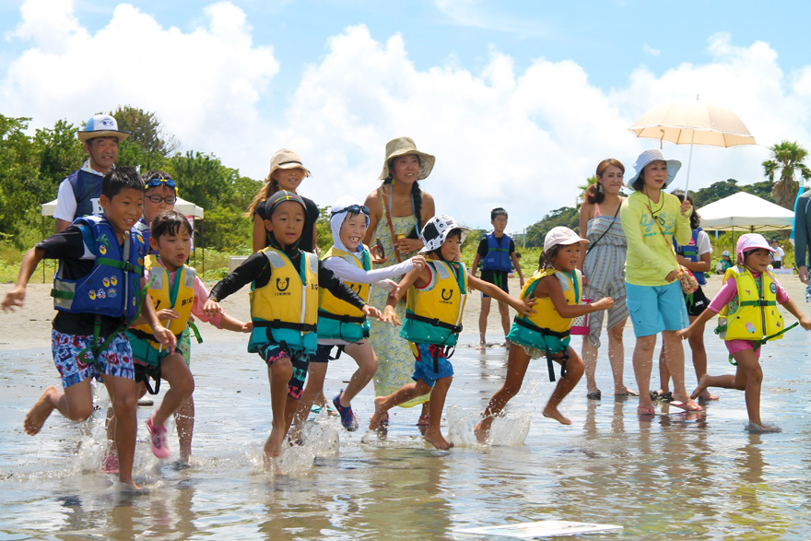
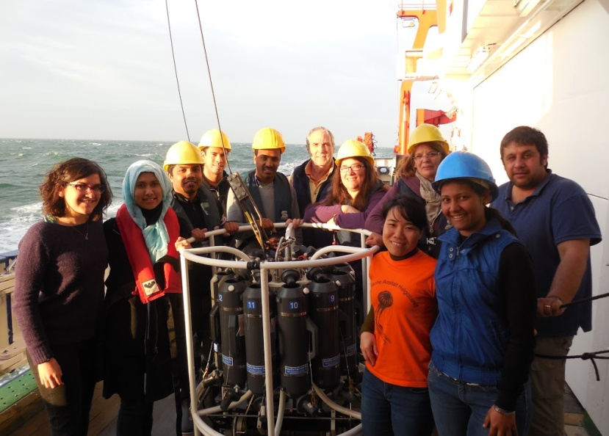
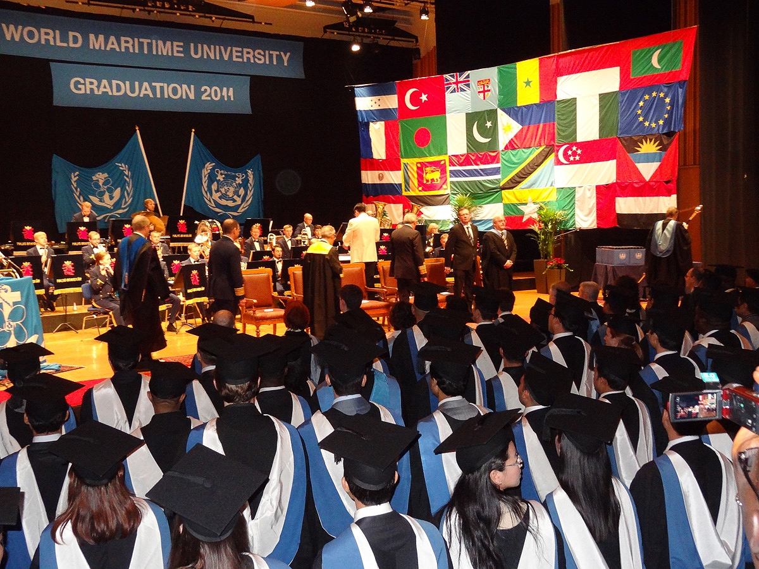
Our Mission
To pass on the riches of the ocean to the next generation

Slide 4
Our means
In order to solve global ocean issues, we need people who are capable of working with others from different fields of expertise, organizations and countries in multidisciplinary initiatives.
Global Human Capacity Building Programs
・Project Period: Since 1998
・Themes: Ocean Governance, Ocean Observation, International Maritime Law
・Partners: UN, International Organizations, Universities & Research Institutions
・Total Number of Fellows: 1,366 across 147 countries (as of Oct. 2019)

Slide 5
Global Human Capacity Building Programs
Partners | Fields of Study | Start date | No. of Fellows
UN DOALOS | International Maritime Law, Ocean Governance | 2003 | 159 (77 countries）
ITLOS | International Maritime Law | 2006 | 76 (63 countries）
Nereus | Oceanography, Marine Ecology etc. | 2010 | 29 (14 counties）
GEBCO | Ocean Bathymetry | 2004 | 90 (40 countries）
IHO | Nautical Cartography | 2009 | 64 (39 countries）
IMLI | International Maritime Law | 2003 | 167 (70 countries）
WMU | Ocean Policy, Maritime Administration | 1998 | 641 (72 countries）
POGO | Ocean Observation | 2003 | 90 (42 countries）
SIRC | Occupational Health & Safety | 2003 (ended in 2016） | 37 (15 countries）
IOGN | Ocean Governance | 2001 (ended in 2011） | 13 (11 countries）
 |  |  | 1,366 (147 countries）

Slide 6
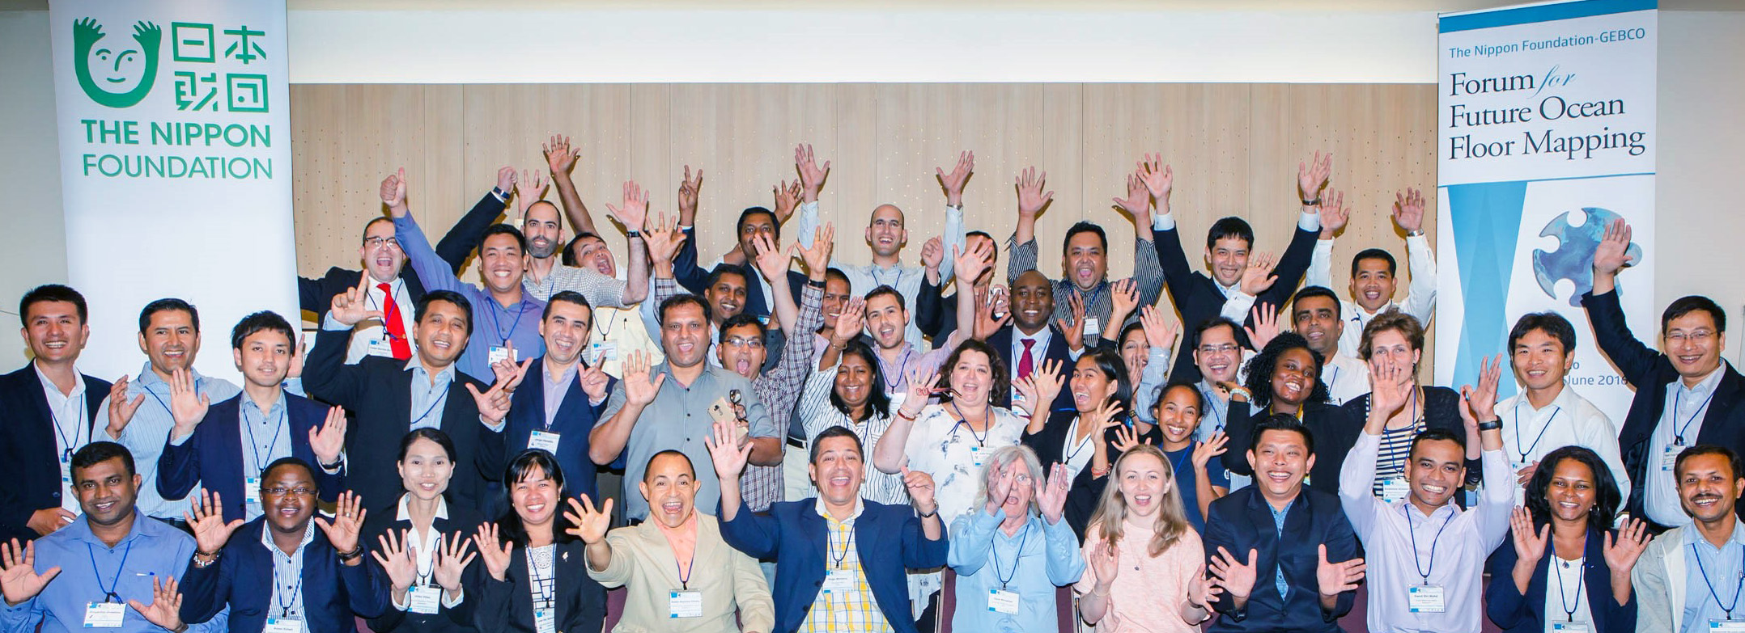
An Illustration of Our Capacity Building Programs: The Nippon Foundation/ GEBCO Training Program
How the Program came about:
The project to map the world’s ocean floor was began in 1903 by Prince Albert I of Monaco but slow progress was being made even after 100 years. One reason behind this was the lack of younger personnel with the required knowledge and skillset to collect and assemble bathymetric data. Recognizing this problem, the Nippon Foundation in collaboration with GEBCO had established a training program at the Uni. of New Hampshire in 2004 to produce a new generation of hydrographers.
Alumni of the Nippon Foundation/
GEBCO Training Program:
As of 2019, 90 fellows from 40 countries
have successfully completed the Program

Slide 7
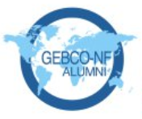
Participation in the Shell Ocean Discovery XPRIZE
The Shell Ocean Discovery XPRIZE:
A $7 million global competition challenging teams to advance deep sea technologies for autonomous, fast, high-resolution ocean mapping.
Background:
・Around the time that this competition was announced, the Nippon Foundation had started to plan a project to map the world’s ocean floor by 2030 – the Nippon Foundation – GEBCO Seabed 2030.
・To map some of the unexplored areas of the seafloor, technology advancement is necessary and we believed that participation in the competition would help to facilitate this.
・16 alumni from 13 countries of the Nippon Foundation/ GEBCO Training Program at UNH came together to form the GEBCO-Nippon Foundation Alumni Team.

Slide 10
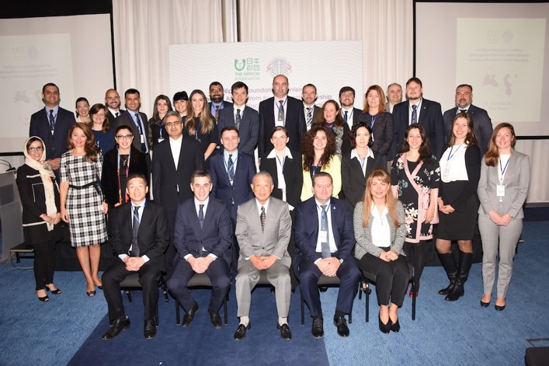
Developments in other Capacity Buildings Programs
1. Collaborations across different Capacity Building Programs
In recent years, the Black Sea and the Caspian Sea have seen depleting fish stock and other environmental impacts due to IUU fishing. A need for a more integrated ocean governance has been identified.
In October 2017, at the suggestion of one UN DOALOS alumni from Georgia, 30 alumni from 4 different capacity building programs (DOALOS, IMLI, ITLOS and WMU) from the Black and Caspian Sea region came together to identify the needs and challenges facing this particular region of the sea and what they can do to help alleviate the problems.

Slide 11
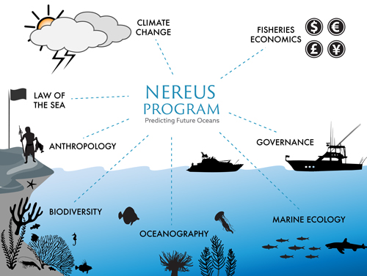
Developments in other Capacity Buildings Programs
2. Collaborations across different disciplines
A global partnership of 17 leading institutes working to advance the comprehensive understanding of the global human-ocean system across the natural and social sciences.
Interdisciplinary collaboration with over 500 researchers.

Slide 12
“Don’t hesitate to take the lead in pioneering innovative collaborations and frameworks to address ocean challenges on a global scale. We, The Nippon Foundation will be there to support you.
Let us work together to protect and preserve our beautiful oceans for our future generations.”
– Chairman Sasakawa

